Slide 1
Energy Supply - electricity
Society Energy Environment systems modelling
Mark Barrett
Mark.Barrett@ucl.ac.uk
UCL Energy Institute

Slide 2
STRUCTURE OF TALK
Scenario context
Overview of problem of meeting variable demands with variable supplies
Variable supplies
  Renewables
Matching demand and supply
  Correlations between demand and renewables
  Demand control
  Storage
  Transmission
Electricity system optimisation with demand side management
Market structure requirements for DSM
Conclusions

Slide 3
INTRODUCTION
The materials presented here describe the development of an electricity scenario for the UK that will result in low emissions of greenhouse gases and other atmospheric pollutants because 85% of electricity is generated from renewable energy sources and 10% from combined heat and power (CHP) partly fuelled with biomass This system is one which might be put in place over the next 30-50 years. Critical to the design of electricity services scenarios, is the overall energy scenario context since this determines general demands, fuels availability and prices, and environmental requirements.
The remainder of this introduction describes some modelling and integrated planning issues.
Then material on the energy scenario context in which the electricity system would be embedded is presented.
Then the detailed development of the electricity scenario is described in these parts:
  the problem of energy demands and supplies in space and time is illustrated
  the components of electricity systems and the system design challenge
  the role of load management
  demand and variable supplies correlation
  the modelling and optimisation of the system to produce a least cost scenario
  discussion of the scenario
  consideration of other options and further scenario development
An illustration of the potential for integrating the UK electricity system with Europe and beyond is then given.
Finally, a brief discussion of the issue of supply security is presented.
Please note that slides with “animated” in the title are animated. The animations may take a few seconds to start, and they loop endlessly. Simply go to the next slide as normal when you have finished viewing.

Slide 4
Modelling the energy demand and supply system: the challenge
The energy demand and supply system needs to be analysed on different temporal and spatial scales. This system is globally interconnected, but some connections are strong (e.g. intra-UK electricity system) while others are weak (UK gas and African oil demand)
Time scales
Demands and renewable supplies vary with social activity patterns and the weather. There can be significant variations over seconds, minutes, hours, days, day of week, months and years.
Spatial scales
Energy systems may be described on different spatial scales: from an individual boiler, to buildings, to local, regional, national and international levels.
The modelling challenge
No model can represent details of the whole system at all temporal and spatial levels. The art is to achieve a balance so that all important processes and energy policy options are covered.

Slide 5
The energy system: demand and supply options
Energy demands and sources interact and can be combined in limitless ways.

Slide 6
SCENARIO CONTEXT
The provision of electricity services can not be planned in isolation from the overall UK, and indeed, European energy systems. Energy planning should be integrated across all segments of demand and supply. If this is not done, the system may be technically dysfunctional or economically suboptimal. Energy supply requirements are dependent on the sizes and variations in demands, and this depends on future social patterns and demand management. Some materials on the scenario context are presented here. These are extracted from a comprehensive UK energy scenario that is under development using a model called SEEScen ; a presentation on this is to be found here: http://www.bartlett.ucl.ac.uk/markbarrett/Energy/UKEnergy/UKEneScenarioAnim140206.zip/
Some examples of integrated planning issues are:
In 2040, what will electricity demand be at 4 am? If it is small, how will it affect the economics of supply options with large inflexible units, such as nuclear power?
The output from CHP plants depends on how much heat they provide, so the contribution of micro-CHP in houses to electricity supply depends on the levels of insulation in dwellings.
Electric vehicles will add to electricity demand, but they reduce the need for scarce liquid fuels and add to electricity storage capacity which aids renewable integration.
Electricity supply systems with a large renewable component require flexible demand management, storage, electricity trade and back-up generation; large coal or nuclear stations do not fit well into such systems because their output cannot easily be varied over short time periods.
The amount of liquid biofuels that might available for air transport depends on how much biomass can be supplied, and demands on it for other uses, such as road transport.
Is it better to burn biomass in CHP plants and produce electricity for electric vehicles, or inefficiently convert it to biofuels for use in conventional engines?

Slide 7
Scenario context: Domestic sector: house heat loss factors
Implementation of space heat demand management (insulation, ventilation control) depends on housing needs and stock types, replacement rates, applicability of technologies

Slide 8
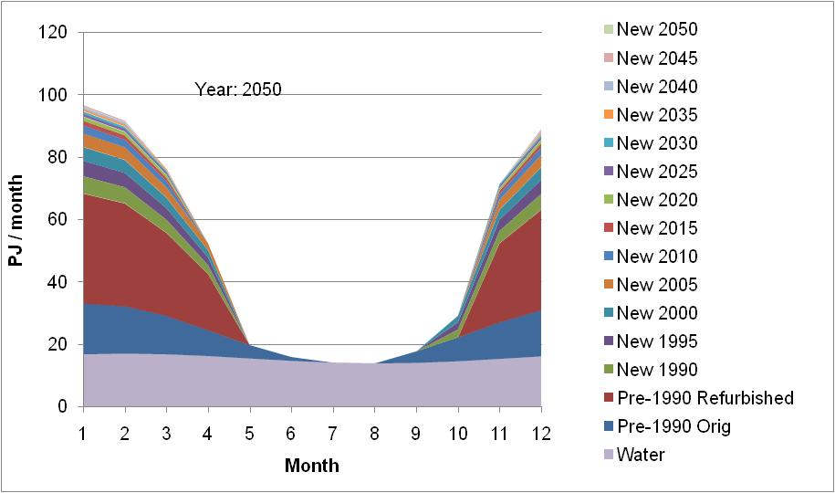
UK dwellings scenario : monthly heat demand
With reduced annual space heating:
Space heat demand has lower load factor (average/maximum) because heating season shortened
Overall heat demand load factor changes little because of water heating fraction
Note: these are monthly factors
How to model temporal and spatial diversity across building stocks?

Slide 9
UK dwellings scenario : diurnal space and water heat demand
2005
2050
This is an example of heat demand, net of incidental solar and internal gains, without any storage
How will heat demand vary by house type?
Again, how to model temporal and spatial diversity across building stocks?

Slide 10
Scenario context: domestic sector: electricity use
Electricity demand is reduced because of more efficient appliances, including heat pumps for space heating.

Slide 11
Scenario context: energy flow charts
The flow charts show basic flows in 1990 and 2050, and an animation of 1990-2050. These illustrate the relative magnitude of the flows.
Note that the scale of these charts varies.
Observations:
Energy services:
  space heating decreases
  other demands increase, especially motive power and transport
Fuel supply
  increase in efficiency (CHP)
  increase in renewable heating, biomass and electricity
  imports of gas and oil are required
  electricity is exported

Slide 12
Scenario context: UK Energy flow chart: 1990

Slide 13

Scenario context: UK Energy flow chart: animation 1990 to 2050

Slide 14
Scenario context: UK Energy flow chart: 2050

Slide 15
Scenario context: electricity generating capacity
Capacity increases because renewables (especially solar) and CHP have low capacity factors. Some fossil capacity is retained for back-up and security.

Slide 16
Scenario context: electricity generation
Finite fuelled electricity-only generation is replaced by renewables and CHP. The proportion of fossil back-up generation depends on a complex of factors not analysed with SEEScen.

Slide 17
GREEN LIGHT: AN ELECTRICITY SCENARIO
The preceding section has set out the context of an overall energy scenario and system.
SEEScen has a main focus on annual flows, although it can simulate seasonal and hourly flows.
Electricity supply in the scenarios requires more analysis of demand and supply technicalities and economics, particularly:
future technology costs, particularly of solar-electric systems such as photovoltaic
demand characteristics including load management and storage
renewable supply mix and integration
Other models are required to analyse issues arising with short term variations in demand and supply, and with the spatial location of demands and supplies.
Questions arising:
Can energy service demands be met hour by hour?
What spatial issues might arise? Increasing the geographical range of electricity systems increases the temporal diversity of demand and supply.
What is the best balance between :
  local supply and long distance transmission?
  demand management, variable supply, optional or back up generation and system or local storage?
These questions can be posed for different time scales (hour by hour, by day of week, seasonal) and spatial scales (community, national, international). The EleServe, EST and InterTrade models have been used to illustrate the issues and indicate possible solutions for integrating spatially separate energy demands and sources, each with different temporal characteristics. Currently the models are not closely integrated.
The following material describe the development of an electricity service system in which 95% of electricity is generated from variable renewable and CHP sources sited in the UK. The principal options exercised in Green Light are the increase of generation from variable renewable sources (contributing 85%) and CHP (10%).

Slide 18
GREEN LIGHT: AN ELECTRICITY SCENARIO
Options exercised in the overall energy scenario:
Phase out of nuclear generation, but with some fossil (coal, oil, gas) capacity retained for back-up
Large scale introduction of renewable electricity
Use of CHP, but limited by the scarcity of suitable non-fossil fuels
Utilisation of biomass for generation

Slide 19
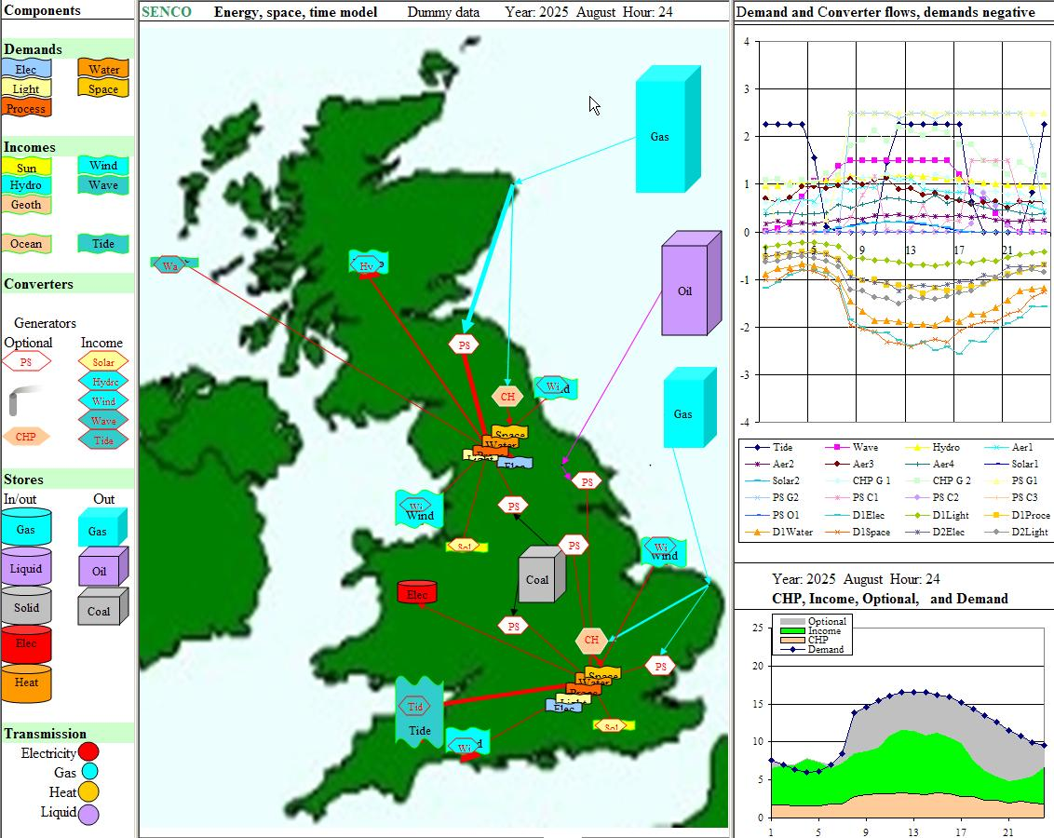
UK energy, space and time illustrated with EST

Slide 20
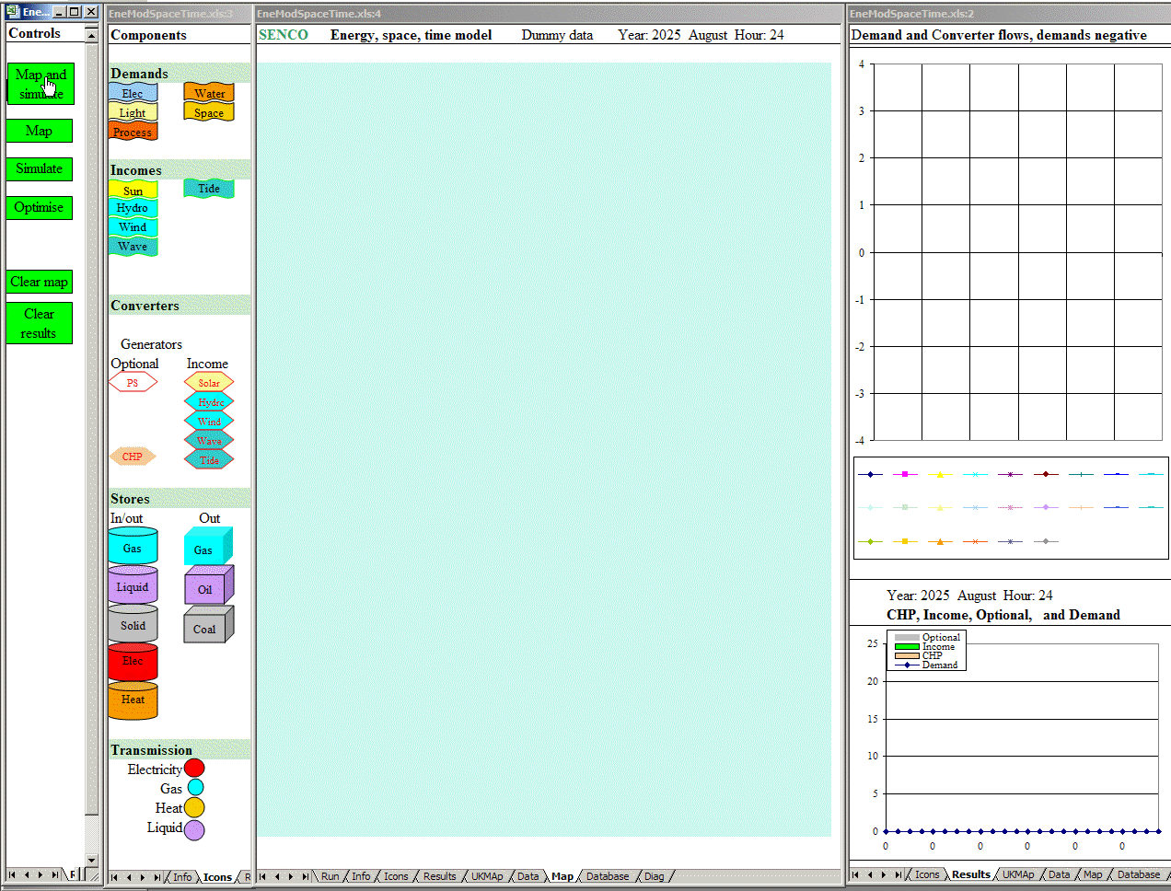
UK energy, space and time illustrated with EST : animated

Slide 21
Energy, space and time problem
What is the best configuration?
What capacities?
Where to locate converters and stores?
Where to place transmission nodes?

Slide 22
Electricity system design with variable sources : elements 1
Electricity demands
energy services - type, temperature, quantity, time, weather dependency (and correlation with renewables)
  non-heat (motive, lighting, equipment) and storable heating/cooling
  interruptible load
end use technologies; control, storage, interruptibility
  space and water heaters, fridges, freezers, dishwashers, clothes washers
multi-fuelled energy services
  electric/ solar / gas heating
  electric / liquid fuelled hybrid cars
Energy storage
Parameters
  energy form input, output and stored (electricity, heat, ..)
  storage capacity (J)
  input and output power (W)
Type and system location
  end use storage
    embedded in end use technologies (building thermal mass, refrigerators)
    purpose built (hot water tank, solid heat storage heater)
  local /neighbourhood storage
    batteries/electrolyte recharging garage for refuelling electric vehicles
  system storage
    pumped storage or other (compressed air/flywheels)

Slide 23
Electricity system design with variable sources : elements 2
Generation
Renewable
  resource intensity variation in space and time of hydro, wind, wave, solar, tidal, biomass
  technology output variation a function of resource variation and design
    minimum/ maximum resource intensity for operation
    efficiency variation with resource intensity
  manipulation of technology output variation
    spatial distribution of wind, wave, solar, tidal energy collectors
    technology design; solar collection orientation, tidal scheme configuration
CHP
  heat load size and temporal variation
  CHP technology; variable heat: electricity ratio
Back-up; biomass, fossil, nuclear
Regional and international transmission linkage
System operation
  prediction in time and space of demand and supply
  control of demand, storage and supply technologies

Slide 24
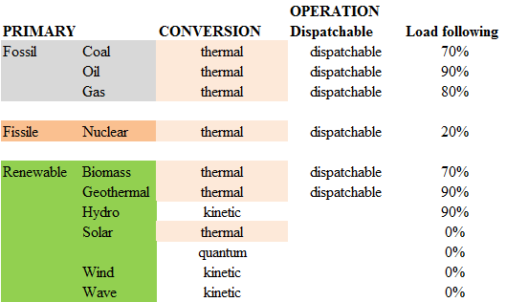
Technologies : power stations

Slide 25
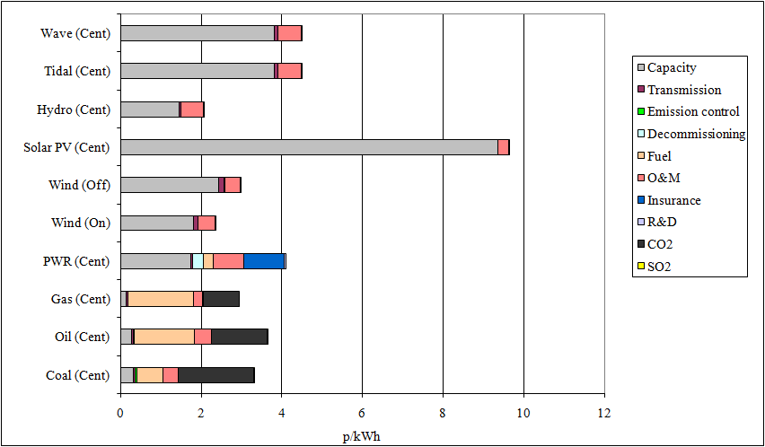
Technologies : power station costs
Note sensitivities to different elements

Slide 26
Energy systems : multi-fuelling
Multi-fuelling of demands
Some demands can be met by more than one fuel which can have benefits and disbenefits.
For example:
water heating might be met by a mix of solar, gas and electric heat.
  solar heating and solar electricity generation are highly correlated and so cannot be used for substitution
  gas or some storable fuel could be used when insolation (or other renewable) is low, but this supply would have a low capacity factor.
hybrid electric/liquid fuelled vehicles.
  when renewable electricity supply is low, a greater fraction of vehicle energy comes from liquid fuel.
Multi-fuelling has these disbenefits:
capital costs are high because several supply technologies are required
the net demand on the auxiliary fuel (e.g. gas) becomes peaky and problematic and therefore an easily stored fuel such as biomass, coal or oil might be advantageous

Slide 27
Energy systems : operational issues
The design and operation of systems depends on the reliability with which demands and supplies can be predicted over different time scales, from minutes to months, and the sophistication of the control of demand and supply technologies. As the UK electricity system becomes increasingly integrated with the European system and systems further afield, the design and operation of the systems will become more complex.
Prediction
The accurate prediction of demands and supplies will become more critical, mainly because of the larger variable renewable component of supply and its consequences for the operational management of demands, storage and trade. However, prediction will improve with the refinement of weather and other data and of simulation models.
  weather forecasting will become more precise
  energy efficiency and demand management reduces the less predictable, weather dependent loads such space heating and lighting
  demand prediction will become more accurate as models improve
  predicting outputs from variable sources will become more accurate
Technology control
Communications and information processing technologies are already adequate for the very precise control of demand technologies, generators and storage.

Slide 28
EleServe : matching demand to supply with load management
The EleServe model has these components:
Electricity demand
disaggregated into segments across sectors and end uses
each segment with
  a temporal profile
  load management characteristics
Electricity supply
each renewable source with own temporal profile
heat related CHP generation with its own temporal profile
optional thermal generators characterised by energy costs at full and part load, and for energy and economic costs of spinning reserve, and heating up plants to bring on stream
trade and system storage
Operational control
load management: demands are moved if the net cost of a move is negative, accounting for differences in marginal supply costs, energy losses and other operational costs
optional units brought on line to minimise diurnal costs

Slide 29
EleServe : matching demand to supply with load management
The following graphs demonstrates the role that load management can play in integrating variable renewables and CHP into electricity supply. Heat and electricity storage (hot water tanks, storage heaters, vehicle batteries) can be used to store renewable energy when it is available, so that the energy can later be used when needed. Other demands, such as refrigerators, can be manipulated or interrupted. In this example of load management, only heat demands are managed with storage.
The System graph summarises:
  system demand
  variable supply (essential)
  trade
  reserve requirement
  system storage (pumped storage)
  optional supply required to meet difference between demand + storage and variable supply
The Demand graph shows each component of demand across the sectors.
The Marginal costs graph shows the energy costs of generation, the costs of starting up plant, and the distribution costs (currently a simple constant).
The Generation graph shows the output from each generation source, in order from bottom to top:
  renewable sources
  CHP
  optional generation ordered by increasing steady state marginal cost (excluding startup costs); this order can vary with fuel prices

Slide 30
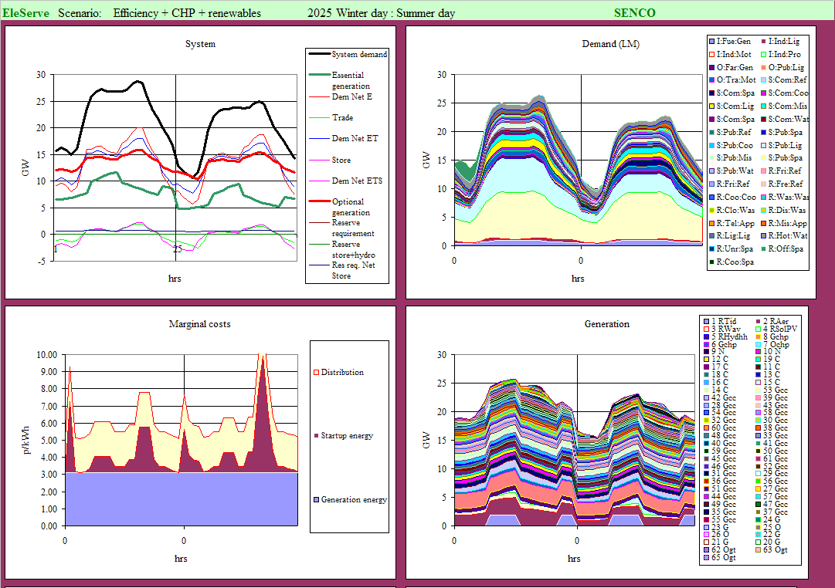
Electricity : diurnal operation without load management

Slide 31

Electricity : animated load management optimisation

Slide 32
Electricity : diurnal operation after load management

Slide 33
EleServe : matching demand to supply with load management
The simulation with the EleServe model demonstrates how a variable electricity supply of about 50% of peak demand, using heat storage alone, can be absorbed such that the net demand met by optional generation is levelled.
This indicates that a large fraction of variable electricity supply can be absorbed into the electricity system without special measures other than the control of heat stores. This fraction might be extended if the potential for the manipulation of other demands were exploited.
The question then is how the bulk of supply requirement might be met with variable renewable and CHP generation.

Slide 34
Future electricity demands
Future electricity service demands depend on the scenario context.
The demands for electricity for electricity-specific services that can use no other fuel (computers, communications, lighting, some motive power...) will generally decrease because efficiency gains will be larger than growth factors such as population.
The usage of electricity for heating depends on the relative availability and prices of other fuels that can perform this function.
The replacement of liquid fossil fuels is perhaps the most difficult problem to solve . Electric vehicles are assumed to make large inroads into the car and light haulage markets. Vehicles are mostly in use during times of high electricity demand, and so their batteries would be predominantly charged at off-peak times thus reducing the diurnal variation in total electricity demand.
Electricity service demands are divided into six categories, each with different weather dependencies, use patterns and service storability.
The use of electricity for making fuels such as hydrogen is currently excluded from the scenario even though it acts as storage and can replace some fossil liquid fuels. This is because such fuel manufacture is inefficient and should therefore be avoided if possible.

Slide 35
Demand: electric vehicles
Currently UK road vehicles consume about 42 million tonnes of oil, equivalent to 490 TWh. If half of this is replaced by oil in electric vehicles (EVs) or hybrid electric vehicles (HEVs) using electricity and a liquid or gaseous fuel which require 15% of the energy of petrol cars per mile, because of more efficient bodies and motors, then the electricity demand of EVs would be about 37 TWh.
Electric vehicles such as trams or trolley-buses draw energy whenever required but they are restricted to routes with power provided by rails or overhead wires. Presently there are no economic and practical means for providing power in a more flexible way to cars in use, consequently electric cars have to store energy in batteries. The performance in terms of the range and speed of EVs and HELVs is improving steadily such that EVs can meet large fraction of typical car duties; the range of many current electric cars is 100-200 miles and would need to be recharged every five days or so, on average. A major difficulty with EVs is recharging them. At present, car mounted photovoltaic collectors are too expensive and would provide inadequate energy, particularly in winter, although they may eventually provide some of the energy required.
Currently the most practical EV refuelling options are:
  Charging the batteries within vehicles. The EVs then have to be connected to the grid and, at present, this can only be done practically when the car is parked. The problem then is providing a safe, secure and convenient grid connection. This may not be too hard at a work car park, or domestic garage, but many cars are parked in the street because houses have no off-road parking.
  Charging the batteries or electrolytes at a garage. In this case charging is of batteries outside of EVs and therefore the EVs can be is use; but battery capacity in addition to that in EVs is required.
  Charging HELV batteries within vehicles using the conventional motor.

Slide 36
Further analysis: electric vehicles
The logistics and economics of these options are complex to explore, especially with HELVs, and the best compromise might be some combination of the refuelling options.
If hydrogen were to be competitive with electricity on economic or technical grounds, it would make little difference to the optimisation since, from the electricity system ‘viewpoint’, hydrogen in fuel cells is more or less indistinguishable from electricity storage in batteries.
Currently, in Green Light it is simply assumed that the diurnal pattern of electric vehicle (EV) use reflects typical car traffic pattern, and that the demand for battery charging is the mirror image of this; EVs are connected for charging when they are not in use.

Slide 37
Demand and supply correlation: general considerations
The planning of electricity supply should include detailed demand analysis, because:
Weather variables are correlated
Energy demands vary with time because of social activity patterns and weather
Renewable energy supply is weather dependent.
The firm capacity of renewables is that amount of switchable (biomass/fossil/nuclear) capacity that doesn’t have to be built to meet demands with a certain probability. The firm capacity of a renewable depends on the correlated variations in demands and that renewable supply, and the variations in some demands depend on the same weather parameters as the outputs from some renewables.
To illustrate:
if solar PV were to meet space heating demand, its firm capacity would probably be close to 0%; if it were to meet air-conditioning demand it might be 50% as large A/C loads occur at times of high insolation.
a significant fraction of space heating is positively correlated to wind speed and wind power, because it increases ventilation losses; whereas A/C load is negatively correlated with wind.
The table summarises these relationships, where ‘+’ means an increase of demand or supply flow with weather parameter. Note that the locations of demand and supply have to be accounted for; in general, the greater their separation, the less correlation between weather parameters.

Slide 38
Demand and supply correlation : example; building heat loss and wind
The heat loss factors (W/C) from buildings due to ventilation and convection increase with wind speed. The chart illustrates these changes in a well insulated house, along with wind power, which increases as the cube of wind speed within the aerogenerator operating range. Assuming 10 M houses with temperature difference (internal-ambient) of 10 C, then the total heat loss from these houses rises from 13 GW to 16 GW as wind speed increases from 0 to 10 m/s. Note this ignores time lags due to building thermal mass and difference in demand and supply location,

Slide 39
Renewable electricity sources
Cost and performance figures for the renewable technologies have been taken from a number of sources. For most of these, the cost reductions that might occur over the next 20-40 years time have to be projected, with uncertainties being particularly large for wave and tidal power for which there is little commercial experience, and for photovoltaics where there may be technical step changes. The total economic energy resources available from renewables depends largely on the cost of competing fuels – the greater the cost of other fuels, the greater the ‘economic’ renewable resource. There are, however, technical limits to some renewable sources, most notably hydro and waste biomass.
The Table summarises some estimates of the potential of renewable electricity for 2020. This is mainly based on Technical and economic potential of renewable energy generating technologies: Potentials and cost reductions to 2020 (PIU, 2001). Of particular note is the projected cost of Building Integrated Photovoltaics (BIPV). The tidal lagoon estimates are quoted in A Severn barrage or tidal lagoons? (FoE Cymru, 2004). In Green Light, conservative estimates have been made for costs in that most are higher than in this table.

Slide 40
CHP
The potential electricity and heat outputs of CHP depend on :
  future low-temperature heat demands
  the fraction of these demands that might be met with available, cost-effective combustible fuels, or other source of high temperature heat
  the CHP technologies available as characterised by efficiency and heat:electricity ratios.
These factors depend on the scenario context for CHP.
The current CHP electricity output is about 27 TWh of electricity from 5.6 GWe capacity. Some estimates (e.g. The Government’s Strategy for Combined Heat and Power to 2010) place the potential to be in the range 50-100 TWh for large scale and micro-CHP, corresponding to about 20 GW capacity, but:
  this assumes heat loads which may actually be smaller in scenarios with high energy efficiency
  a major fraction of this CHP would use imported fossil fuels, mostly gas, which will become scarce, expensive, and carbon emitting.
Accordingly, in the scenario it is assumed that CHP potential is ultimately limited to that which may be fuelled with biomass — 5.5 GW at a 45% load factor producing 22 TWh of electricity. However, during the period leading to a fully sustainable, renewables-based system, gas and other fuels used for heating and electricity should be used in CHP plant where possible. A scenario in which gas CHP increases and then declines over the next 40-50 years may be envisaged. Heat distribution networks developed for CHP would facilitate the economic introduction of other heat sources such as electric heat pumps or solar energy as gas supplies become scarce.

Slide 41
Trade
Currently it is assumed that there is sufficient diversity that the UK can import or export as much as the capacity of the international link will allow (set at a maximum 6 GW as compared to the current 2 GW) at any time. This is a strong assumption, but the capacity of interconnection across and outside Europe will almost certainly increase. This issue is taken up later.

Slide 42
Electricity demand and supply summary
Demands, variable supplies and stores are summarised in this table. The annuitised costs of capital are calculated using a 5% discount rate.
For this initial development of the scenario, the renewable sources are each represented by one ‘farm’ at a ‘site’ except for wind which is at two sites. Together they have a potential maximum of 132 GW generating 266 TWh/a. This simplification means that temporal diversity is not fully exploited, and that no account is made of different technology types.
Currently just two stores are assumed: one for electricity (with the minimum set at current UK pumped storage) and one for heat.

Slide 43
Modelling the integrated system
The VarInt module of the EST model is used to simulate and optimise the system.
It includes these steps:
Randomised weather is generated using seasonal and diurnal patterns with auto-correlation
Hourly demands, dependent on weather and use patterns, are calculated
Supply requirement accounting for transmission losses is calculated
CHP supply is calculated from heat loads
Renewable supply is calculated from weather parameters (with correlation with demand weather)
Excesses and deficits of variable energy as compared to demand are calculated
Excesses and deficits are allocated in such a way as to minimise the loss of energy or exergy, as follows:
  Excesses are sent, in order of increasing loss until capacity is filled, to:
    trade export (about 95% efficient)
    electricity storage (about 80% efficient)
    heat storage (about 98% efficient, but electrical energy recovered as heat)
  Deficits are met, in this order until capacity is exhausted, from:
    heat storage
    electricity storage
    trade import
    any remaining deficit is met with optional generation (e.g. biomass or coal)
  This algorithm is simple, and its implementation results in in rapid changes to the flows which may not be optimal. These flows would probably be subject to more sophisticated control as illustrated by the EleServe load management optimisation.
The total costs of supplying electricity are calculated. Note that these costs currently exclude transmission and distribution costs which would have to added in to arrive at delivered costs to the consumer.

Slide 44
Demand and supply day sampling
VarInt works in two modes:
Sampling runs of weather from a day to a year to :
  estimate the storage capacity (GWh, GW) required to meet deficits and ensure no renewable energy wastage
  check the optimisation results
Optimisation: the minimum cost of meeting a given fraction of demand from variable sources is found.

Slide 45
VarInt : Sample winter days
The following shows sample winter days with excesses and deficits of variable supply.
The Resources chart shows:
  ambient temperature (Tamb_D), solar intensity (Solar) and wind speed (Wind_D) at demand location
  wind speeds (m/s), wave intensity (kW/m) and height of tide (m) at generation locations
The Demands and supply chart shows :
  weather dependent demands: air conditioning, lighting, space heat
  weather independent, electricity specific demands
  ‘additional demands’: inputs to stores, outputs to trade
  transmission/transformation/distribution losses (constant, not varying with load)
The Supplies and demand chart shows :
  renewable generation: hydro, tidal, wave, aerogeneration , solar generation
  CHP
  ‘additional supplies’: outputs from stores, inputs from trade
  optional generation which can be supplied at any time
The Cumulative demand and supply chart shows cumulative total demand and supply; the maximum difference between these determines storage needs for the day.

Slide 46
VarInt : Sample day : winter’s day of variable supply excess

Slide 47
VarInt : Sample day : winter’s day of variable supply deficit

Slide 48

VarInt : Day sampling : animation

Slide 49
Demand and supply day sampling
This illustrative modelling indicates how variable renewable and CHP electricity might be absorbed using system and ‘sub-system’ storage.
In practice, not all demand-supply mismatch would be absorbed with storage as it would not be the least-cost option.
System planning would take into account the statistics of the variations in demand and supply.
For the dummy data, the histograms shows some statistics from 500 random sample days based on dummy data:
  On about 10% of the days, storage requirement is greater than about half the maximum.
  Although the average energy deficit is zero, the distribution is skewed

Slide 50
Diurnal storage : illustrative configuration
For sample dummy data and weather functions modelled, approximate storage needs were calculated for the worst days in which storage capacity is maximum in terms of GW and GWh.
This is a maximum day’s storage scenario in that it assumes:
  no interruptible or degradable demands
  no ‘firm’ generation from biomass, fossil or nuclear fuels
  no electricity trade, either import or export
The current UK system level storage capacity provided by pumped storage is about 2 GW power and 10 GWh energy.
Residual needs can be met by ‘sub-system’ storage at the neighbourhood or building/vehicle level. For illustration, it is assumed that about half of the residual need is provided each by:
  25 M hot water tanks in buildings of capacity 450 litres and maximum temperature change 20 C (e.g. 40 C to 60 C) providing 11 kWh energy storage per tank, and a heat input power of 0.4 kW
  10 M electric vehicle battery sets in cars, local garages, etc. of energy capacity 43 kWh and power capacity 1.2 kW. Current vehicle batteries are around 30 kWh. Note that a fraction of in-vehicle batteries can not be used when vehicles are not grid connected.

Slide 51
VarInt : Optimisation over a year
To find the best combination of generation, trade and storage options, optimisation is used. The procedure is as follows:
For a fixed run of random weather data, the optimiser tries out different values for the capacities of the technologies until the cheapest combination is found.
This combination may then be tested against random weather to see if the system delivers electricity services securely in all circumstances.
The optimisation has these objectives and constraints:
Objective: Find the minimum total cost of electricity supply, where costs currently include;
Capital and running costs of generation and storage
Energy costs of optional generation (biomass, fossil) and trade
Decision variables:
Capacities of variable generators, optional generation and stores
Constraints:
Demands met
Fraction of optional generation less than some specified fraction
Renewable capacities less than ‘economic’ maximum
Flows and energy storage limited by capacities
The optimisation is run for sample days representing a year of weather.

Slide 52
VarInt : Optimisation methods
Finding the optimum is a difficult problem because the energy system is highly non-linear, especially with storage. The optimisation is carried out with a combination of methods:
  a genetic algorithm (GA) that is good for searching for a wide variety of combinations
  a downhill (or hill climbing) method that efficiently finds local optima precisely
Operated alternately, these methods find feasible, low cost solutions quite rapidly. The chart on the lower right shows the diminishing returns of the optimisation.
There is no guarantee that the optimisation will find the best combination for technical and other reasons. However, given the nature of the problem, it is unlikely that much better solutions exist. In any case, the optimum depends on many assumptions about demands and technologies some decades in the future.
In SENCO’s Optimiser, the algorithms are coded in Visual Basic for Applications (VBA) and operated in an Excel environment.

Slide 53
VarInt : Graphs
Four graphs depict the hourly values of climate and flows in the electricity system for sample days from each season.
The Resources graph shows the hourly variations in climate and renewable energy resources.
  ambient temperature (Tamb_D), solar intensity (Solar) and wind speed (Wind_D) at the demand location
  wind speeds (m/s), wave intensity (kW/m) and height of tide (m) at generation locations
The Demands graph shows the demands that are highly weather dependent (air conditioning, lighting and space heating), and less weather dependent demands (water heating, transport, electricity specific).
The Supplies graph shows the outputs from the electricity sources, with trade being shown positive as an area if it is incoming, and as negative as line if it is outgoing.
The Stores graph shows the amounts of energy in the electricity and heat stores (thick lines), and the flows in and out of the stores as positive and negative respectively (thin lines)

Slide 54
VarInt : Optimisation problem
Given this sample year pattern of renewable resources, weather and demands, what is the optimum combination of generation, trade and storage to meet demand?

Slide 55

VarInt : Optimisation: year graph animated
The animation shows the year sample as the optimiser seeks the least cost mix of supply and storage for fixed weather and renewable resources.

Slide 56

VarInt : Optimisation :annual summary animated
The animation shows the annual summary as the optimiser seeks the best mix of supply and storage.

Slide 57
VarInt : Optimised system : sample year
These charts show the sampled year performance of the optimised system for one set of weather.

Slide 58
VarInt : Testing the solution against random weather
The optimum combination found is for one fixed pattern of random weather. This combination then needs to be tested against further samples of random weather to see if it delivers services reliably under a range of weather and renewable resource conditions.
To do this, the optimum combination of technologies is retained, and the weather varied randomly for a number of sample years. The following animation shows this testing.

Slide 59
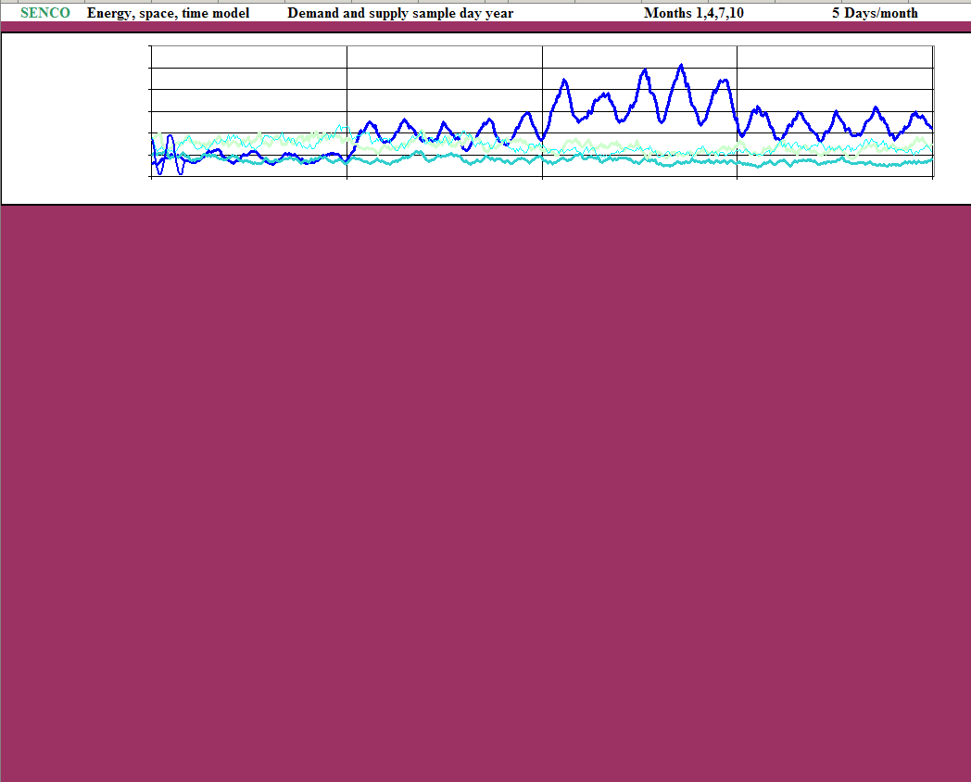
VarInt : Testing the solution against random weather : animated

Slide 60
VarInt : Optimised system : demand and technology details
The table below shows some details of the optimised system. Yellow cells contain assumptions; those with bold type are the values changed by the optimiser. The tan cells contain minimum and maximum allowable values. Of note are the energy generated, the capacity factors, and the unit cost of electricity generation shown in the last row.

Slide 61
VarInt : Optimised system : technical summary
The charts depict the capacities of the generators and trade link, and of the electricity and heat stores.
The table summarises the energy flows and peak demands.

Slide 62
VarInt : Optimised system: economic summary
The table shows the total cost of the system and the average unit price of electricity. Both of these will vary from year to year because of weather induced changes to demand; and to supply, particularly of trade and optional generation. The annual cost of the renewables does not change significantly, except for expenditure on maintenance that is related to energy output for that year.
The pie chart shows the distribution of annualised expenditure.

Slide 63
Green Light : discussion 1
The optimisation demonstrates that an electricity system with very high penetrations (95%) of variable renewables (85%) and CHP (10%) can deliver energy services to consumers reliably. It further demonstrates that the unit cost of electricity (about 5 p/kWh) may not excessive as compared to future fossil or nuclear generation costs. The future unit cost of electricity will probably be higher than today in any scenario because of capital cost and fuel price increases: either in a high renewable future; or one with large fractions of fossil and nuclear generation.
The Green Light scenario is more secure than high fossil/fissile scenarios because:
  it is almost immune to unpredictable future prices and availability of finite fuels
  it incorporates a mix of low risk, reversible technologies
It is not claimed that this system is necessarily the best because it does not include all the possible options in terms of technologies or operational strategy. The optimal system depends on the many assumptions about future demands, and the performance and costs of generation, storage and transmission technologies. Changes in these assumptions will lead to different solutions. However, some of the costs and technicalities of a working system have been demonstrated, and the challenge is to find better solutions.

Slide 64
Green Light : discussion 2
If demands are assumed to be higher than in the scenarios, then renewables and CHP would have to generate more if the same fraction of low carbon sources were to be maintained.
The Table showing renewable resources gave estimates that although the total ‘economic’ potential might be 266 TWh, the technical potential is some 4800 TWh, with photovoltaics alone being 266 TWh of this. Therefore, there is scope for a considerable expansion of renewable generation beyond that assumed in Green Light. Technical problems and costs will increase as more of this further potential is realised, but to increase renewable output to 400-500 TWh in 40-50 years time may not be an unreasonable target. Technology forecasting on such a long time scale is inevitably speculative, but if photovoltaic costs were to fall further, and its efficiency to increase, then renewable supply potential would be transformed. Finally, it is to be noted that the UK might invest in renewables in other countries, and gain carbon credits in that way.
In Green Light, the CHP maximum capacity is 6 GWe generating 23 TWh. Other studies have estimated that the potential might be 2-4 times as much as this - another 25-75 TWh. Such additional CHP would probably use gas as liquid fuels are a premium for transport, and biomass energy is limited.

Slide 65
Green Light : discussion 3
Green Light uses the constraint of a maximum of 5% of generation from optional sources giving an average electricity cost of 5.1 p/kWh. Optimisations were carried out for:
80% CHP and renewable generation, resulting in an average cost of 4.9 p/kWh.
100% CHP and optional generation, resulting in an average cost of 6.5 p/kWh; most of the increase being due to electricity storage.
As the fraction of variable electricity sources approaches 100%:
  the average cost of electricity increases
  there will be increased problems of variable energy deficits and surpluses.
    Deficits are easier to accommodate because the control strategy for them requires short-term prediction (up to a day) of needs which may be covered with optional generation
    Surpluses have to be spilled (wasted), put into storage, or exported. The exercise of these options requires more complex planning over longer time periods (days, weeks, or even months)

Slide 66
Optional generation and biomass
Optional generation
As the fraction of variable generation increases, the capacity factor of optional generation decreases, unless the capacities of trade and storage are increased. In the optimised system, the capacity factor of the 6.4 GW of optional generation ranges between 10% and 20%. This capacity and energy generation could be met with a mix of existing private generation (about 10 GW) and main fossil plants (about 45 GW). The economics of the options of retaining existing capacity, or building new plant requires further analysis.
It is unlikely that coal (with carbon dioxide sequestration) or nuclear generation would be the best choice for such optional generation because of technical reasons (load following) and cost, even if the safety and environmental risks of these technologies were acceptable. More likely is that further trade or storage would be the optimum choice.
Biomass
CHP and optional generation supply about 30 TWh. About half of the energy required for this generation could, if it were the best option, be met with waste biomass used as a sole or supplementary fuel, as shown in the Table. Then over 90% of the UK’s electricity would be met with renewable resources. Energy crops could add to this, depending on environmental acceptability and economic feasibility.

Slide 67
Further options 1
Green Light does not include all possible options, and therefore cheaper solutions may be found for the assumed electricity service demands. These other options could include:
Demand :
  More load management with interruptible demands, or varying fraction of electricity/liquid fuels in hybrid vehicles, etc.
  Other demands, such as the production of fuels such as hydrogen, which can also provide some storage
Renewable energy:
  Currently all renewables are at one ‘site’, apart from wind which is at two. In general, the greater the number of sites, the less the aggregate variability and the consequent demands on storage and back-up generation.
  Other renewable energy sources and technologies such as heat pumps could be included
  Altering the design of technologies can change outputs and economics; for example,
    tidal lagoon or barrage systems incorporate allow some manipulation of generation timing and even some use as pumped storage
    aerogenerator design can be tailored for particular maximum and minimum wind speeds
    solar PV orientation affects seasonal output variation

Slide 68
Further options 2
CHP. The heat : electricity ratio of CHP can be varied through technical control or heat storage so as to aid the matching of supply to demand.
Storage. Presently two types of store are modelled, one electricity store, and one heat store. These could be subdivided into different technologies having different costs, efficiencies, power ratings, cycle times etc; such as pumped storage, compressed air storage or electric vehicle batteries.
A more refined control strategy for the system, particularly of flows to storage and trade, could be developed. Currently, the operational strategy is fixed.

Slide 69
Further modelling
The modelling and optimisation could be improved to incorporate transmission issues, increase accuracy and to find lower cost solutions.
The modelling could be elaborated:
Demand management decision variables such as interruptibility and efficiency costs could be included.
Control strategy parameters for operating demand management, storable renewables (hydro, tidal) stores, CHP and trade could be variable.
Transmission planning, costs and constraints within the UK, or within Europe could be included.
More analysis of the different categories of demand in terms of quantity, use patterns, weather dependency and control.
The use of real time series of renewable resources (temperatures, insolation, wind speeds, tidal flows, wave intensity).
More refined technology modelling; e.g. more realistic efficiency curves
More sample hours for a year’s simulation
The optimisation could be extended to include 1-3 as decision variables.

Slide 70
Economics: component costs
If the performance and relative costs of the technologies changed, then so would the shape of the optimum systems. Assumptions about storage and photovoltaic technologies are perhaps the most critical.
Beyond this other costs could be included:
  transmission and distribution costs
  system operation and control (e.g. of stores) costs
If electricity storage were cheaper and more efficient, then more use could be made of the cheapest renewables, or those with less environmental impact.
Photovoltaic (PV) generation has perhaps the least environmental impact of the renewable sources. In addition, most PV would be sited near demand, on buildings, where maintenance and transmission needs and costs would be less than for the remote sources. An interesting question then is how a reduction in the relative cost of PV would increase its contribution. The optimisation indicates that the PV generation would increase to about 30 TWh if its capital cost were £1500 per kW. This is still more expensive than wind, but as PV generates more in the summer, it balances the supply from wind and wave which peaks in the winter.

Slide 71
Economics: modelling
Currently a single set of costs (capital, O&M, etc.) is assigned to each technology. In reality there is a range of costs dependent on the particularities of the resources, and whether the technology installations are new, or existing. These varying costs can relate to the technologies themselves, and to other costs such as those engendered by transmission network development. The unit costs of technologies generally decrease with total installed capacity because of economies of scale and ‘technology learning’.
These features can be modelled in various ways.
The technologies can be subdivided: for example, into
  new and existing installations
  on-shore and off-shore wind
  low head and high head hydro
  solar PV applied to new buildings or retrofitted to old
  CHP grouped by size of heat load and temporal variation and/ or load factor
  length of transmission link and whether over ground, underground or submarine
Cost functions can be used. For example, the capital costs of PV might increase from £1500/kW for fitting 10 GW to new buildings to £2500/kW for retrofitting
A combination of these two methods would probably be the best approach.

Slide 72
Further economic detail 2
It is to be noted that the potential and costs of renewable generation exclude an account of their environmental impacts. It may be that the development of, say, on-shore wind power or tidal lagoon power, would be constrained to less than their economic potential as determined by direct costs because of impacts. Such considerations could be included in the optimisation by reducing the maximum capacity allowed or by attaching monetary values to the impacts.

Slide 73
Security: generalities 1
Energy security can be defined as the maintenance of safe, economic energy services for social wellbeing and economic development, without excessive environmental degradation. All forms of energy supply (renewable, fossil, nuclear) present some form of insecurity.
A hierarchy of importance for energy services can be constructed:
Core services which it is immediately dangerous to interrupt
  food supply
  domestic space heating, lighting
  emergency services; health, fire, police
Intermediate importance. Provision of social services and short-lived essential commodities
Lower importance. Long-lived and inessential commodities
Part of security planning is for these energy services to degrade gracefully to the core.
The various energy supply sources and technologies pose different kinds of insecurity:
renewable sources are, to a degree, variable and/or unpredictable, except for biomass
finite fossil and nuclear fuels suffer volatile increases in prices and ultimate unavailability
some technologies present potentially large risks or irreversibility

Slide 74
Security : generalities 2
Supply security over different time scales
Gross availability of supply over future years. The main security is to reduce dependence on the imports of gas, oil and nuclear fuels and electricity through demand management and the development of renewable energy.
Meeting seasonal and diurnal variations. This mainly causes difficulty with electricity, gas, and renewables except for biomass. Demand management reduces the seasonal variation in demand and thence the supply capacity problem for finite fuels and electricity. Storage and geographical extension of the system alleviates the problem.
Security of economic supply.
Demand management reduces the costs of supply.
  The gross quantities of fuel imports are less, and therefore the marginal and average prices
  The reduced variations in demand bring reduced peak demands needs and therefore lower capacity costs and utilisation of the marginal high cost supplies
The greater the fraction of renewable supply, the less the impact of imported fossil or nuclear fuel price rise
A diverse mix of safe supplies each with small unit size will reduce the risks of a generic technology failure
Security from technology failure or attack. In the UK, the largest risk, in terms of event size, is nuclear power.
Security from irreversible technology risk. In the UK, nuclear power and carbon sequestration are effectively
Environment impacts. All energy sources and technologies have impacts, but the main concern here are long term, effectively irreversible, regional and global impacts. The greater the use of demand management and renewable energy, the less fossil and nuclear, the less such large impacts.

Slide 75
Electricity security
Demand management will reduce generation and peak capacity requirements as it :
reduces total demand
reduces the seasonal variation in demand, and thence maximum capacity requirements
It has been illustrated how load management might contribute to the matching of demand with variable supply. This can be further extended with storage, control and interruptible demand.
Existing and new fossil or biomass generators could be used to meet any deficit of CHP and renewable electricity supply. Currently there are about 55 GW of main fossil stations, and 5-10 GW of private generators. A fraction of these could be retained for the long term future, depending on the economics.
Currently in the UK, there are these capacities:
  Coal 19 GW large domestic coal reserve
  Oil 4.5 GW oil held in strategic reserves
  Dual fired 5.6 GW
  Gas 25 GW gas availability depends on other gas demands
It is possible to run some gas fuelled generators with liquid fuels which may be stored for times of deficit. These plant would not then subject the gas supply system to a peaky demand.
Utilisation, if necessary of some end use sector generation. Currently in excess of 7 GW, but some of these plants are less flexible because they are tied to end use production, services and emergency back-up
The building of new flexible plant such as gas turbines if large stations are not suitable
Electricity trade with other countries can be used for balancing. There are geographical differences in the hourly variations of demands and renewable supply because of time zones, weather, etc. The strengthening of the link between France and the UK, and creation of links with other countries would enhance this option.

Slide 76
INTERNATIONAL ELECTRICITY
Wealthy countries like the UK can reduce their energy demands and emissions with cost-effective measures implemented in isolation from other counties, and in so doing improve their security. However, at some point it is more practical and cost-effective to consider how the UK can best solve energy and environment problems in concert with other countries.
As global fossil consumption declines because of availability, cost and the need to control climate change, then energy systems will need to be reinforced, extended and integrated over larger spatial scales. This would be a continuation of the historical development of energy supply that has seen the geographical extension and integration of systems from local through to national and international systems.
The development and operation of these extended systems will have to be more sophisticated than currently. Presently, the bulk of variable demands in rich countries is met with reserves of fossil and nuclear fuels, the output of which can be changed by ‘turning a tap.’ When renewable energy constitutes a large fraction of supply, the matching of demands and supplies is a more complex problem both for planning and constructing a larger scale system, and in operating it.
Just as within the UK, further connecting the UK system to other countries increases the benefits of diversity, at the cost of transmission. The advantages of extending the system include:
  more demand diversity because of different weather and use patterns in other countries
  more supply diversity because of different weather and renewable resource patterns
  access to more renewable energy sources with inherent storage; hydro and biomass
The following materials illustrate the benefits of this diversity, and what an extended system might look like.

Slide 77
International electricity : demand
The first chart shows the pattern of monthly demands for different European countries.
The second chart shows the normalised diurnal demand patterns for some countries. Note that these are all for ‘local’ time; time zone differences would shift the curves and make the differences larger.

Slide 78
International electricity: supply; monthly hydro output
Hydro will remain the dominant renewable in Europe for some time. It has a marked seasonality in output as shown in the chart; note that hydro output can vary significantly from year to year. Hydro embodies some energy storage and can be used to balance demand and supply, to a degree determined by system design and other factors such as environment.

Slide 79
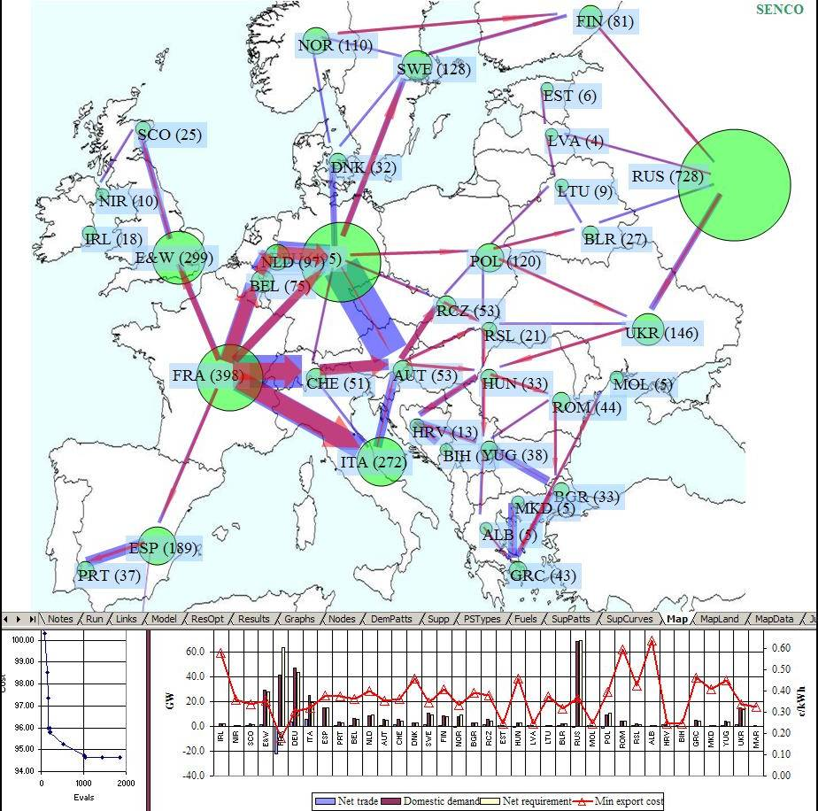
Electricity trade
An extensive continental grid already exists
Diversity of demand and supply variations across geographical regions
What is the best balance between local and remote supply?
InterEnergy model
Trade of energy over links of finite capacity
Time varying demands and supply
Minimise avoidable marginal cost
Marginal cost curves for supply generated by model such as EleServe

Slide 80

InterEnergy – trade optimisation animated
This shows InterEnergy seeking a least cost solution.
It illustrates how patterns of electricity flow might change.
Unlike VarInt this model accounts for transmission constraints.

Slide 81
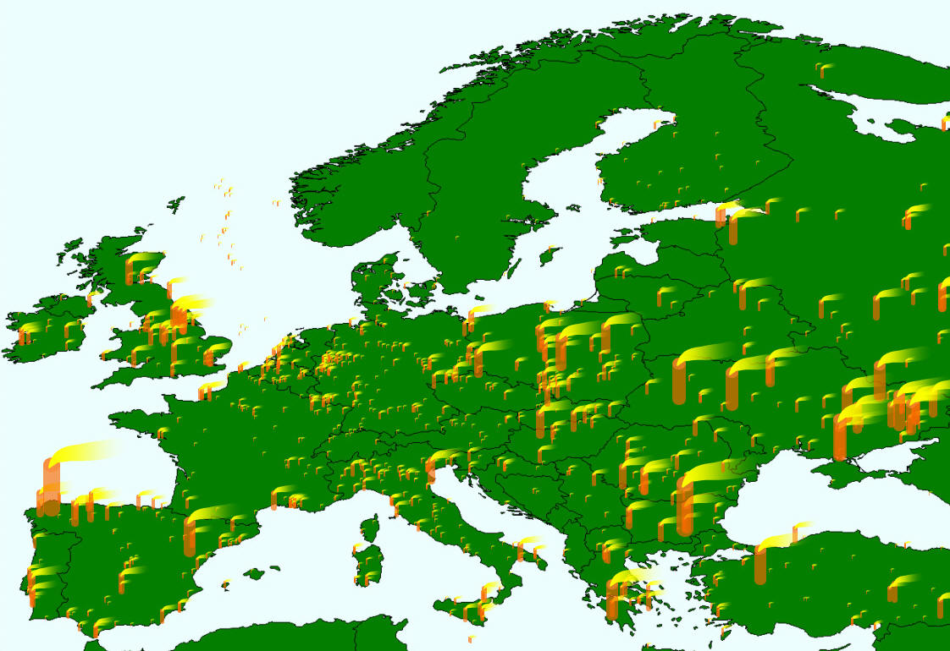
Europe and western Asia – large point sources
The environmental impact of energy is a global issue: what is the best strategy for reducing emissions within a larger region?

Slide 82
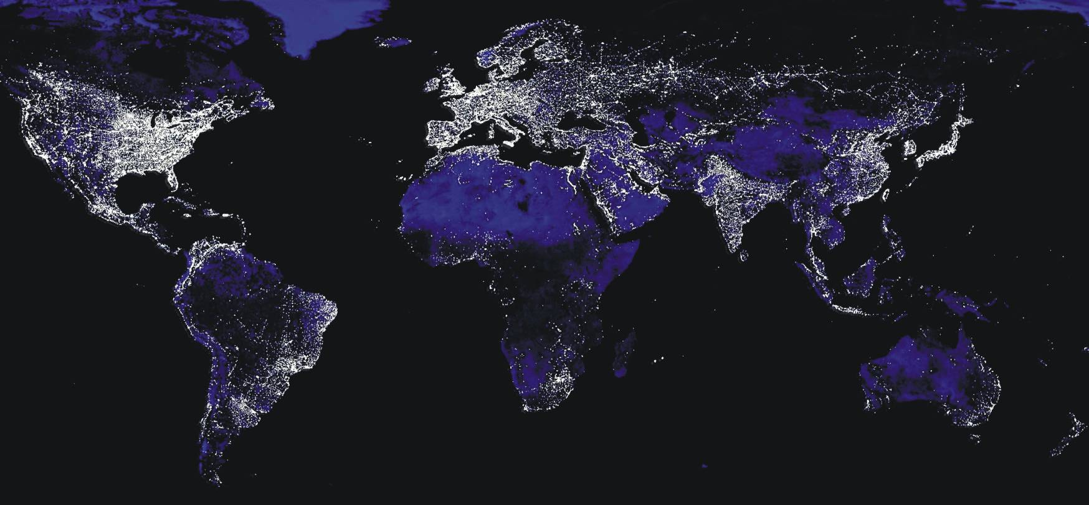
World
There are global patterns in demands and renewable supplies:
Regular diurnal and seasonal variations in demands, some climate dependent
Regular diurnal and seasonal incomes of solar energy
Predictable tidal energy income

Slide 83
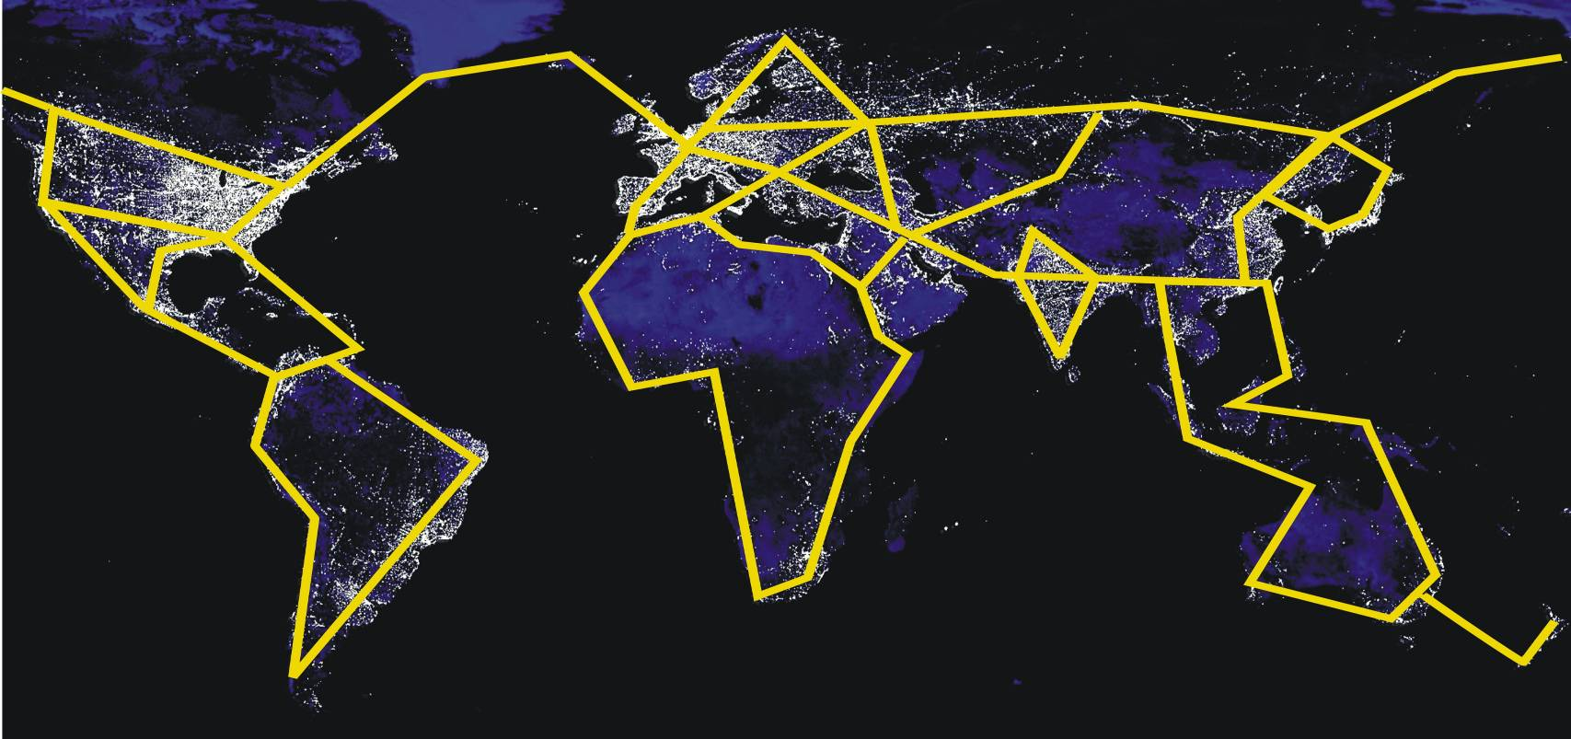
World: a global electricity transmission grid?
Should transmission be global to achieve an optimum balance between supply, transmission and storage?
Which investments are most cost efficient in reducing GHG emission? Should the UK invest in photovoltaic systems in Africa, rather than the UK? This could be done through the Clean Development Mechanism

Slide 84
Energy storage : it’s always been there!

Slide 85
Diurnal storage : illustrative configuration
For sample dummy data and weather functions modelled, approximate storage needs were calculated for the worst days in which storage capacity is maximum in terms of GW and GWh.
This is a maximum day’s storage scenario in that it assumes:
  no interruptible or degradable demands
  no ‘firm’ generation from biomass, fossil or nuclear fuels
  no electricity trade, either import or export
The current UK system level storage capacity provided by pumped storage is about 2 GW power and 10 GWh energy.
Residual needs can be met by ‘sub-system’ storage at the neighbourhood or building/vehicle level. For illustration, it is assumed that about half of the residual need is provided each by:
  25 M hot water tanks in buildings of capacity 450 litres and maximum temperature change 20 C (e.g. 40 C to 60 C) providing 11 kWh energy storage per tank, and a heat input power of 0.4 kW. Total storage 275 GWh.
  10 M electric vehicle battery sets in cars, local garages, etc. of energy capacity 43 kWh and power capacity 1.2 kW. Current vehicle batteries are around 30 kWh. Note that a fraction of in-vehicle batteries can not be used when vehicles are not grid connected. Total storage 430 GWh, but a variable fraction available.

Slide 86
Finding GOD – a market structure for integrating DSM
Devising planning, regulatory and market frameworks that will approach least cost solutions.
Problem: How to deal with 20 GW (+/- 5 GW with some probability distribution) of wind power arriving say 8-12 hours in the future when demand will be 40 GW (+/- 5 GW), so as to minimise cost and achieve required loss of load probability?
Global Optimal Dispatcher (GOD) perfect foreknowledge and power – omniscient, omnipotent.
How to approach GOD in a human system with imperfect foreknowledge, and certain limits on information about system states, information transfer, and on control?
  How to control:
  demand side input/outputs from N million stores/interruptible loads?
  ramping up/down of thermal and other generators?
  trade with France, etc…?
Current market prices are not sufficient. Somehow demand and supply agents have to bid in their future offerings, which are then taken up by a ‘controller/dispatcher’ when the time comes as required, with payments for offers accepted, whether or not there is energy flow. With high renewable % systems the net-of-renewable future demand to be met by optional generation (thermal, hydro…) is very uncertain. When storage is included things get tricky, especially if there are complex constraints, such as for fridge/freezer max/min temperatures

Slide 87
Finding GOD – information (omniscence)
Information about current and future projected states of components of the system
Energy flows and storage, costs

Slide 88
Finding GOD – controlling the system (omnipotence)
Technologies are widely available – sensors, actuators, telecomms, computers but software development needed.
Information flows are small:
  end use premises (internal); e.g. 20 devices at 1 kB/s = 20 kB / s
  national level; e.g.30 M consumers at 1 kB/s = 30 Gb / s
CONTROL options
Centralised
  End users signal centre
  Centre devises strategy and controls end use technologies
Distributed
  End users signal centre
  Centre does projections and signals end users
  End users respond to signals – devise strategy and implement control

Slide 89
GOD (nearly) exists
Plenty of experience and success
IEA DSM programme for general information www.ieadsm.org
UK simple off-peak and interruptible demands
Australia
India
New Zealand
Pacific islands
South Africa
Spain
USA
Etc. etc.

Slide 90
CONCLUSIONS
Demand management a vital component of electricity system design
Storage has always been used in electricity systems.
Heat storage likely to play a larger role as electricity replaces other fuels for heating and renewable fraction increases
How to structure market to implement DSM?
  Technologically simple
  Social market question, but much international experience

Slide 91
Further information
Renewable electricity system: Feasibility of a high renewable electricity system
Barrett, M. 2007, A Renewable Electricity System for the UK. In Renewable Energy and the Grid: The Challenge of Variability, Boyle, G., London: Earthscan. ISBN-13: 978-1-84407-418-1 (hardback).
http://www.cbes.ucl.ac.uk/projects/energyreview/Bartlett%20Response%20to%20Energy%20Review%20-%20electricity.pdf
http://www.bartlett.ucl.ac.uk/markbarrett/Energy/UKEnergy/UKElectricityGreenLight_100506.ppt
Power stations: emissions and health effects
Barrett M, Holland M, April 2008, The Costs and Health Benefits of Reducing Emissions from Power Stations in Europe. Published by the Air Pollution and Climate Secretariat and the European Environmental Bureau. ISBN: 978-91-975883-2-4
ISSN: 1400-4909. http://www.airclim.org/reports/APC20_final.pdf
Barrett M, December 2007, Low Emission Energy Scenarios for the European Union, report 5785. ISBN 91-620-5785-5, ISSN 0282-7298. http://www.naturvardsverket.se/Documents/bokhandeln/620-5785-5.htm
Naturvårdsverket (Swedish environmental protection agency, SE-106 48 Stockholm www.naturvardsverket.se

